Slide 1
Training data-efficient image transformers & distillation through attention
DeiT: ViT-based model for image classification task
Jan 2021, Facebook AI (https://github.com/facebookresearch/deit)

Slide 2
ViT: Vision Transformer
“…CNNs are not required for image classification tasks, and that a pure transformer applied directly to sequences of image patches can perform very well…”
“…When pre-trained on large amounts of data and transferred to multiple mid-sized (ImageNet, CIFAR-100, VTAB, etc.), Vision Transformer (ViT) attains excellent results and requiring substantially fewer computational resources to train…”
However, vision transformers …
Do not generalize well when trained on insufficient amounts of data.

Slide 3
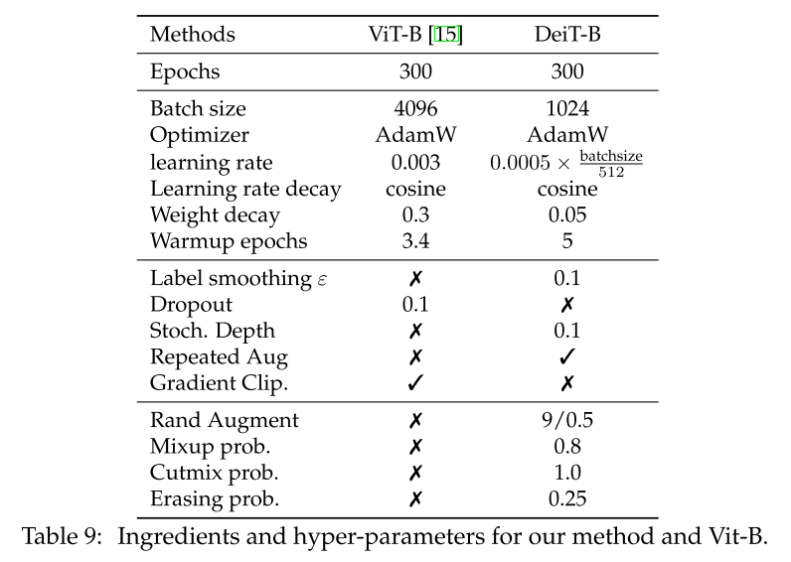
DeiT: data-efficient image transformer
Same architecture as ViT except:
Training dataset: ImageNet 2012 (1.2M)
Training strategies
Hyper-parameter tuning
Data augmentation
Regularization and optimizer
Fine-tuning at different resolution
Distillation token
Joint classifier
Using linear classifier instead of MLP for pre-training to infer image label

Slide 4

Distillation
Having a strong classifier as a teacher
Soft distillation
Minimize the Kullback-Leibler divergence between the softmax of teacher and the softmax of student
Hard distillation
Take the hard decision of the teacher as a true label

Slide 5
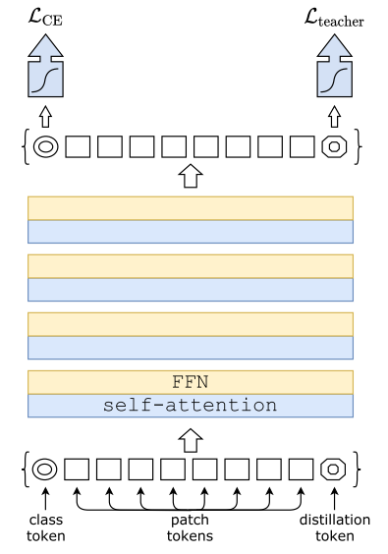
Distillation: distillation token
Having a strong classifier as a teacher
Simply including a new distillation token.
It interacts with the class and patch tokens through the self-attention layer.
It employed in a similar fashion as the class token, except that its objective is to reproduce the (hard) label predicted by teacher model, instead of true label, on the output of the network.

Slide 6
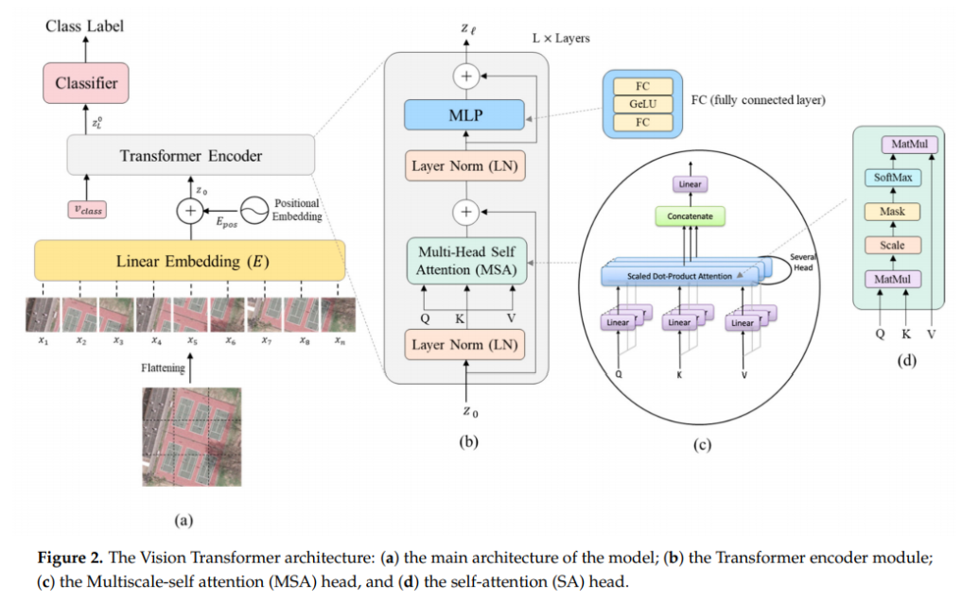
ViT architecture
https://hafoom.com/39

Slide 7
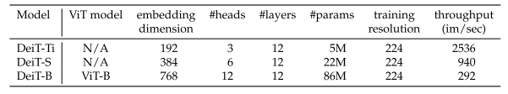
Experiment Result
Transformer (DeiT) models
DeiT-B: reference model (same arch as ViT-B)
DeiT-T (Tiny), DeiT-S (Small): smaller models of DeiT
DeiT⚗ ( ): DeiT models with distillation
DeiT-B↑384: fine-tune DeiT models with higher resolution (usual: 224)

Slide 8
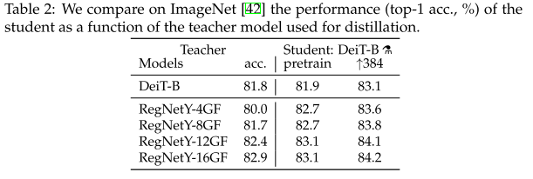
Experiment Result
For distillation, who is a good teacher?
Convnet vs Transformer

Slide 9
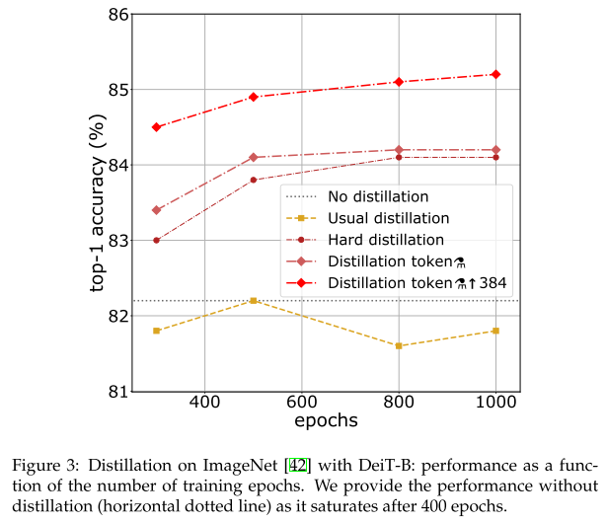
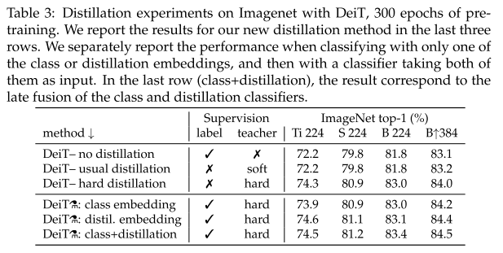
Experiment Result
Which distillation is the best?

Slide 10
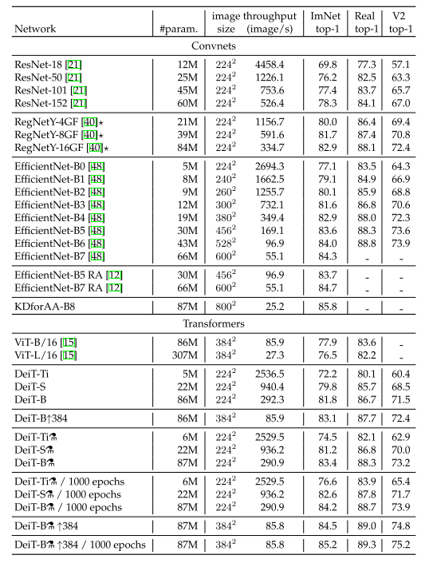
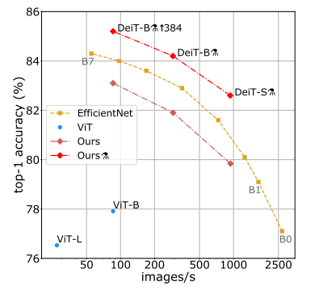
Experiment Result
Efficiency vs Accuracy

Slide 11
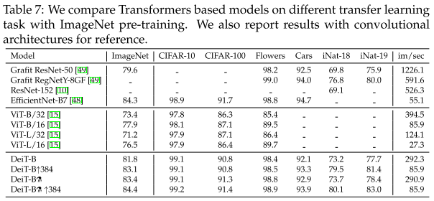
Experiment Result
Transfer learning

Slide 12
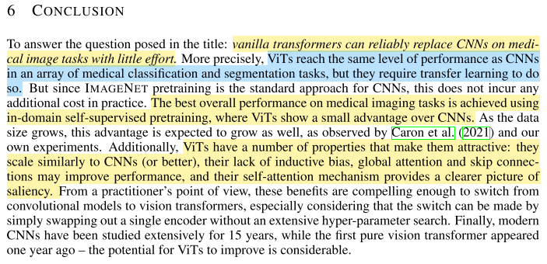
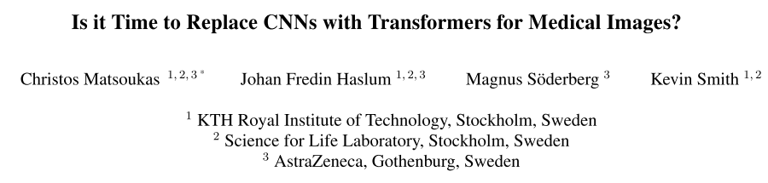
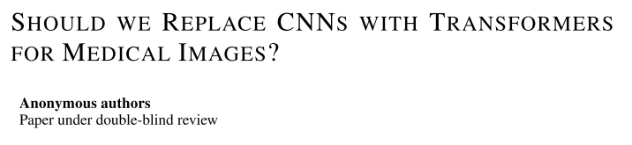
Applying DeiT in Medical domain

Slide 13
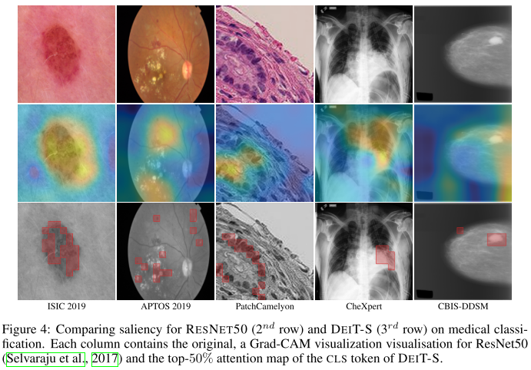
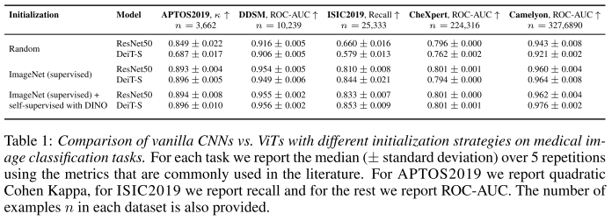
Applying DeiT in Medical domain

Slide 14
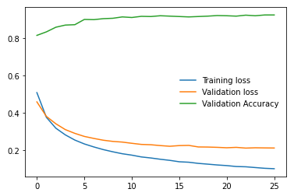

Doing
Transfer learning using pre-trained DeiT model (provided by FB)
Model: DeiT-base (patch size: 16, resolution: 224)
Image transforms: None (same as densenet201)
Dataset: D, M, and N stomach slide from Seegene
Number of train, val, test data: 700, 300, 1000
Performance:
Accuracy: 0.866
Confusion matrix:
Issue found: overfitting during training session.

Slide 15
To do
Overfitting issue
Image transformer: follow the DeiT paper
Transfer learning with distillation
Teacher model: densenet201 (Murtaza’s)
DeiT with DINO (self-supervision)

